Slide 1
Clustering Neighbourhoods in Toronto
26 December 2019

Slide 2
Business requirement
There are more than 1,500 coffee shops in Toronto.
We want to use data science to identify which neighbourhoods in Toronto have a high number of parks and green spaces, but low number of coffee shops – leaving a potential gap in the market.
The output would benefit coffee chains that are all about the location – those renowned for being situated in beautiful places, such as Benugo in the UK.
Without data science, it would be difficult and time consuming for an individual to gather and analyse various disparate sources of information.

Slide 3
Data sources
The project will be performed using the following datasets:
Open data from Wikipedia on Toronto neighbourhoods; this includes a list of each postcode, and their corresponding borough and neighbourhood.
Open data containing the geo-spatial data (longitude and latitude) of each postcode area.
Foursquare API data, containing data on venues and their geo-spatial location.

Slide 4
Methodology
Use Beautiful Soup (python library) to web-scrape the Toronto neighbourhoods data from
Perform data pre-processing and cleansing
Merge with geo-spatial data, to identify the longitude and latitude of each neighbourhood.
Retrieve the corresponding venues in each neighbourhood using FourSquare API, based on the geo-spatial data.
Summarise the outputs to enable analysis.

Slide 5
Opportunities identified
Weston, York Mills West and Kingsway all have attractive looking parks and do not currently have any coffee shops.
Weston and York Mills West have the benefit of also having convenience stores, which indicates a reasonably high footfall that doesn’t have the same target market as a coffee shop.
Kingsway has the benefit of also having a river, which would be an attractive option for luxury coffee shops that seek to be located in the best locations, such as Benugo.

Slide 6
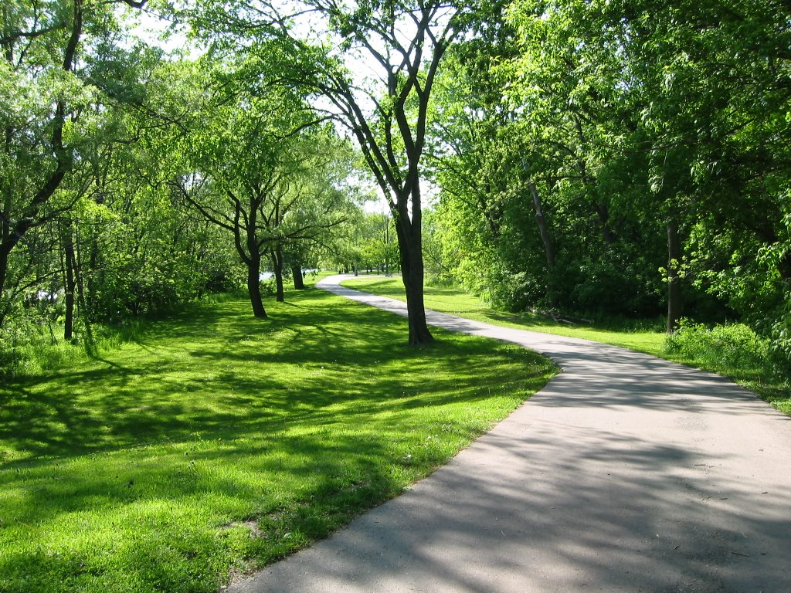
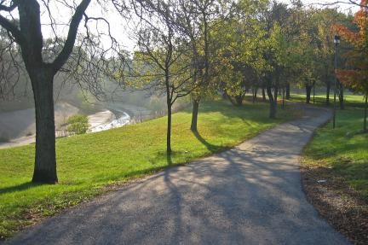
Locations
Cruickshank park in Weston York Mills Valley Park

Slide 7
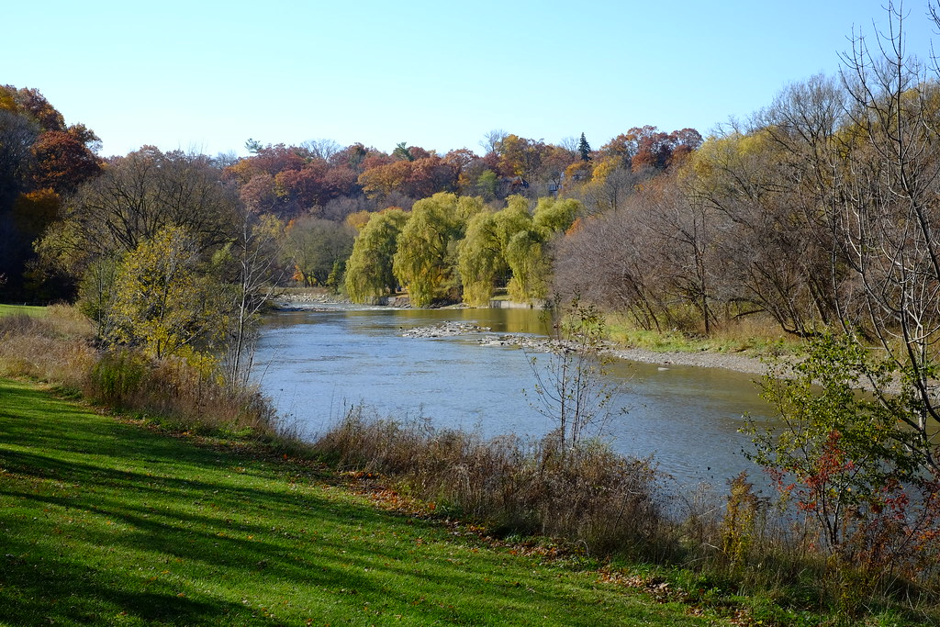
Locations
Magwood Park in Kingsway

Slide 8
Recommendations
It is recommended that further analysis is performed on Weston, and Kingsway York Mills West, to understand the following:
Footfall
Retail space cost per square metre
Retail space availability
Further, it is recommended that focus groups are held to understand
Demand for a coffee shop
Preferences of the target market in that neighbourhood

